Slide 1

Academic Session 2026-27
ODD Semester July-Dec 2026
UNIVERSITY INSTITUTE OF ENGINEERING AND TECHNOLOGY
Department of TT
Bachelor of Engineering (B.E.) – CSE
Advanced Data Structures / Semester 3
(CS220)
Unit No. 1 Chapter No. 1.1 Lecture No. 10
Topic : Quick Sort and Complexity Analysis
Abhishek Thakur (E19789) Technical Trainer
Sourav Jaiswal (E19756)-MSC Technical Trainer

Slide 2
Learning Objectives
Understand the divide-and-conquer strategy used by Quick Sort.
Trace the Partition function and the Quick Sort recursion on an array.
Analyse best, average, and worst-case complexity of Quick Sort.
Identify strategies to avoid worst-case behaviour (pivot selection).

Slide 3
Quick Sort — Algorithm and Partition
Strategy: Divide and Conquer — choose a pivot, partition array so all elements less-than pivot go left, all greater go right.
Partition: PARTITION(A, lo, hi): pivot=A[hi]; i=lo-1; For j=lo to hi-1: if A[j] <= pivot: i++, swap A[i],A[j]; swap A[i+1],A[hi]; return i+1
Quick Sort: QUICKSORT(A, lo, hi): if lo less-than hi: p = PARTITION(A,lo,hi); QUICKSORT(A,lo,p-1); QUICKSORT(A,p+1,hi)
Pivot choice: Last element, first element.

Slide 4
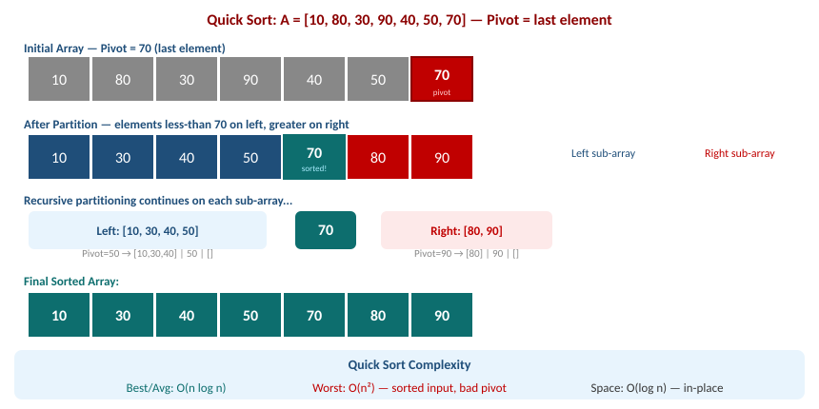
Quick Sort — Partition and Recursion Visual Trace

Slide 5
Quick Sort — Complexity Analysis
Best case: O(n log n) — pivot always splits array into two equal halves (balanced partition).
Average case: O(n log n) — on random input, expected balanced splits; constant factor smaller than Merge Sort.
Worst case: O(n sq.) — pivot is always the smallest or largest element (e.g. sorted array with last-element pivot).
Space complexity: O(log n) average for recursion stack. O(n) worst case (unbalanced recursion).

Slide 6
Summary of the Lecture
Quick Sort uses divide-and-conquer: partition around a pivot, recurse on sub-arrays.
PARTITION places pivot in its correct position; all left elements are smaller, all right are larger.
Best/Average case: O(n log n). Worst case: O(n sq.) with bad pivot on sorted input.
Space: O(log n) average recursion stack. Not stable by default.
Use randomised pivot or median-of-three to avoid worst-case behaviour in practice.

Slide 7

Next Lecture
Merge Sort — merge operation, recursion tree, and guaranteed O(n log n) complexity.

Slide 8
Quiz/ FAQ's
Q1. Trace Quick Sort on A = [3, 6, 8, 10, 1, 2, 1] with last element as pivot. Show partitions.
Q2. Why does Quick Sort have O(n sq.) worst case? When does this occur?
Q3. Compare Quick Sort and Merge Sort in terms of time complexity, space, and stability.

Slide 9
References/ Articles/ Videoseferences/ Articles/ Videos
Cormen et al., Introduction to Algorithms (CLRS), 3rd Ed., MIT Press, Ch. 7.
GeeksforGeeks — Quick Sort: https://www.geeksforgeeks.org/quick-sort/
Visualgo — Sorting: https://visualgo.net/en/sorting

Slide 10
Thank You
For queries
Email: abhishek.e19789@cumail.in

